Slide 1
10 Linux Commands
Osasumwnen Osazuwa

Slide 2
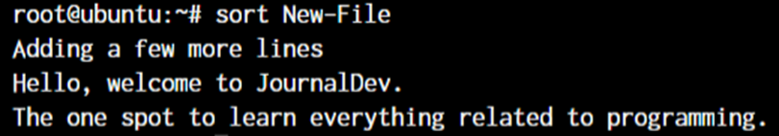
sort
The sort command provides a sorted output of the contents of a file.

Slide 3
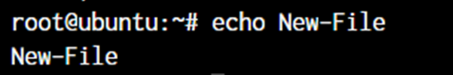
echo
When you want to print anything to the terminal output, we make use of the echo command. When we use echo command, it simply prints any text that follows after the command.

Slide 4
less
The less is used when the output printed by any command is larger than the screen space and needs scrolling. It allows use to break down the output and scroll through it with the use of the enter or space keys.
The simple way to do this is with the use of the pipe operator (|).

Slide 5
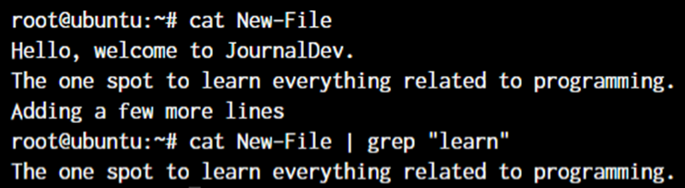
grep
If you wish to search for a specific string within an output, the grep command comes into the picture. We can pipe (|) the output to the grep command and extract the required string.

Slide 6
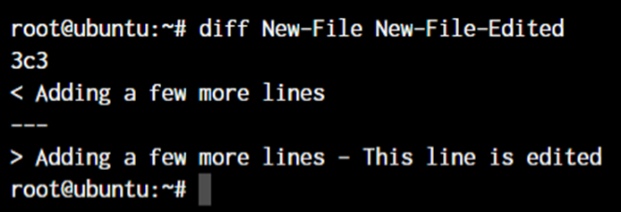
diff
The diff command finds difference between files.

Slide 7
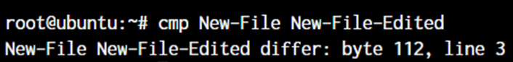
cmp
The cmp command allows you to check if two files are identical. If they’re not, it only tells us the line number which is different between the files and not the actual text.

Slide 8
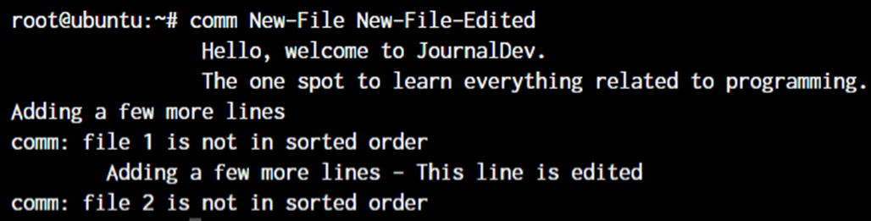
comm
The comm command combines the functionality of diff and cmp.
The text that’s aligned to the left is the text that’s only present in file 1. The center-aligned text is present only in file 2. And the right-aligned text is present in both the files.

Slide 9
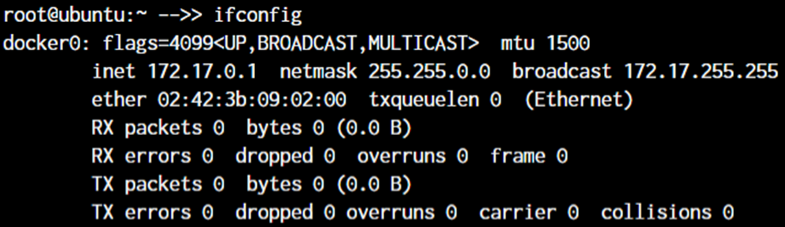
ifconfig
The ifconfig command will give you the list of all the network interfaces along with the IP addresses, MAC addresses and other information about the interface.

Slide 10
whatis
The whatis command gives us an explanation of what a command actually is and what it is use for.

Slide 11
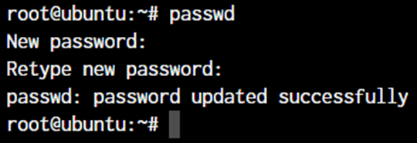
passwd
The passwd command lets you set the password for your own account, or if you have the permissions, set the password for other accounts.

